Slide 1


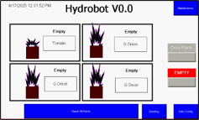
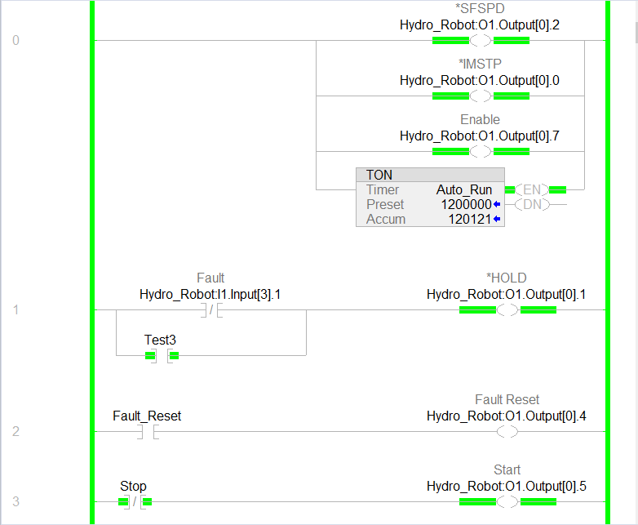
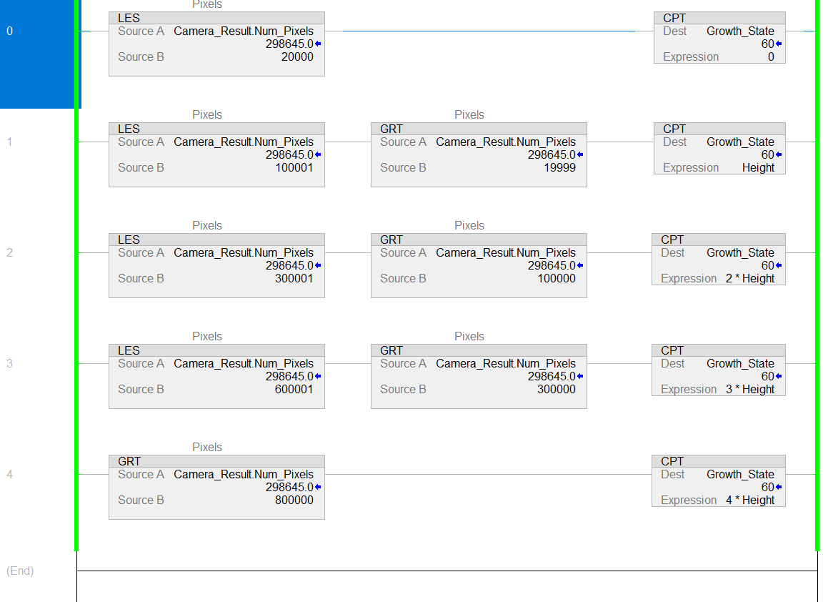
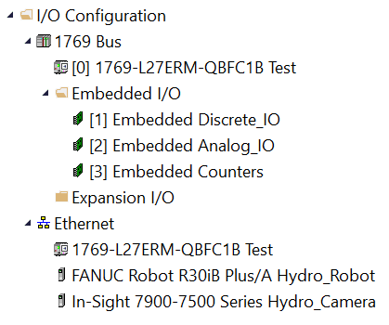
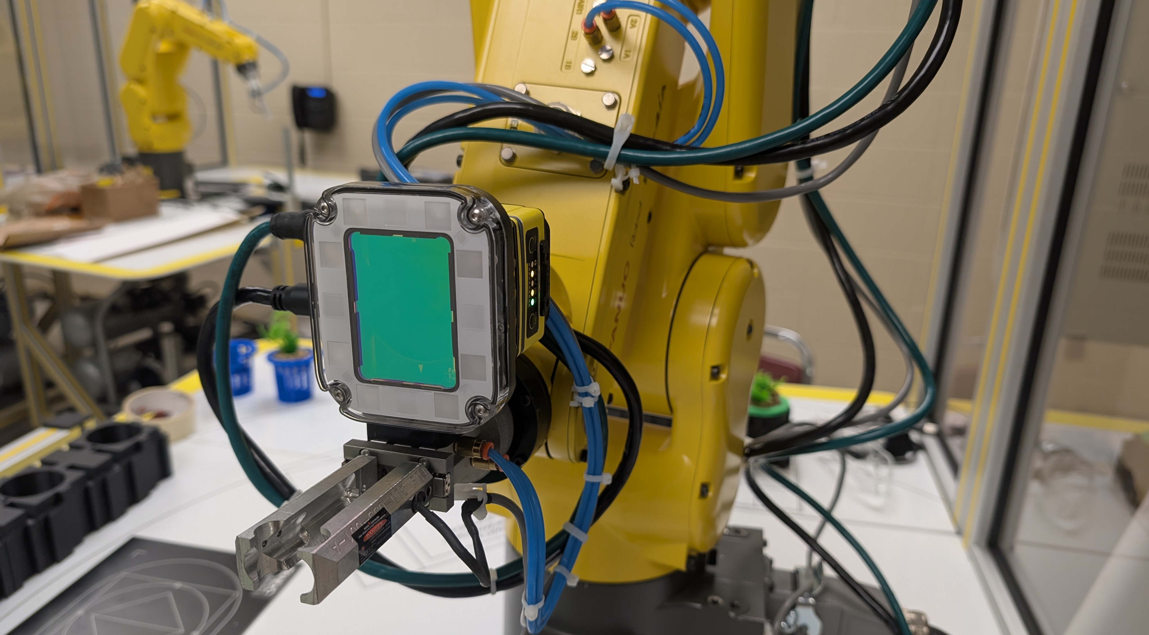
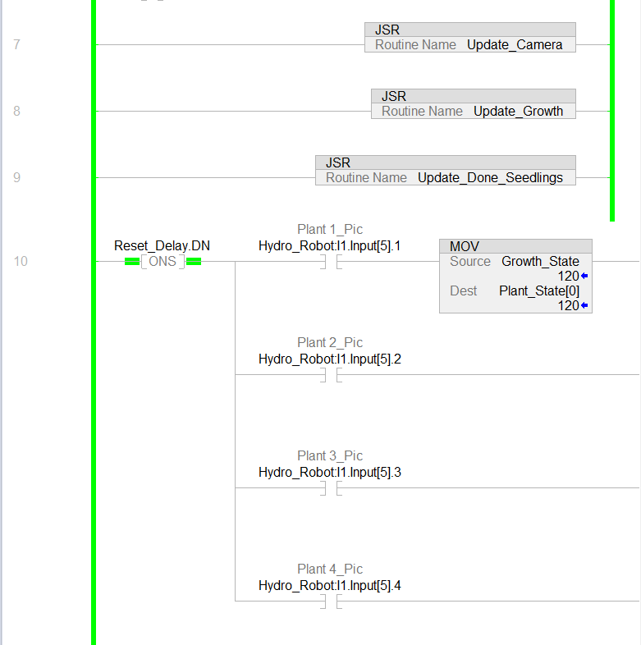
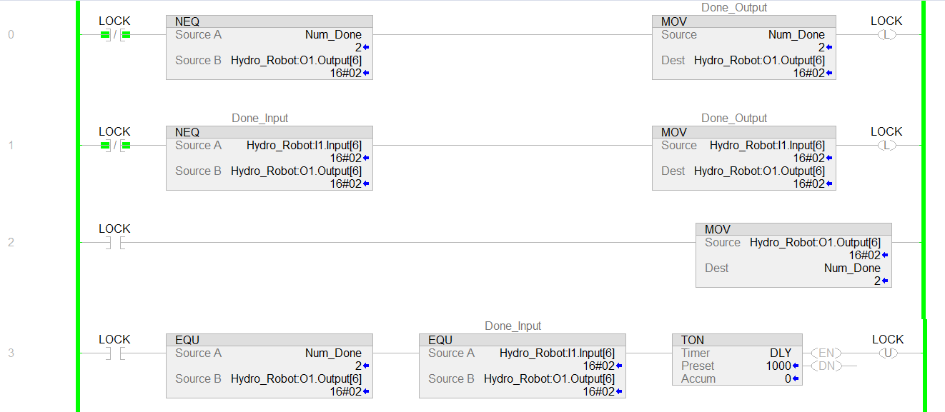
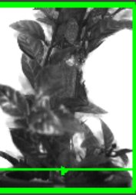
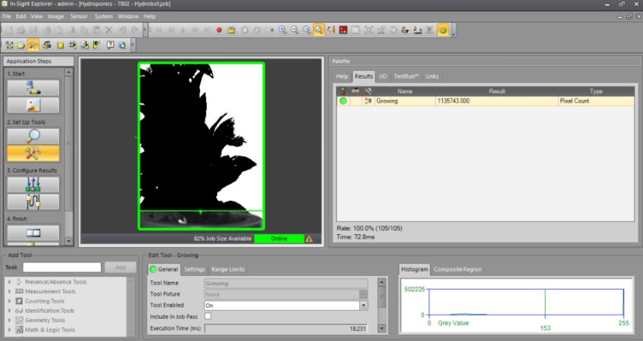
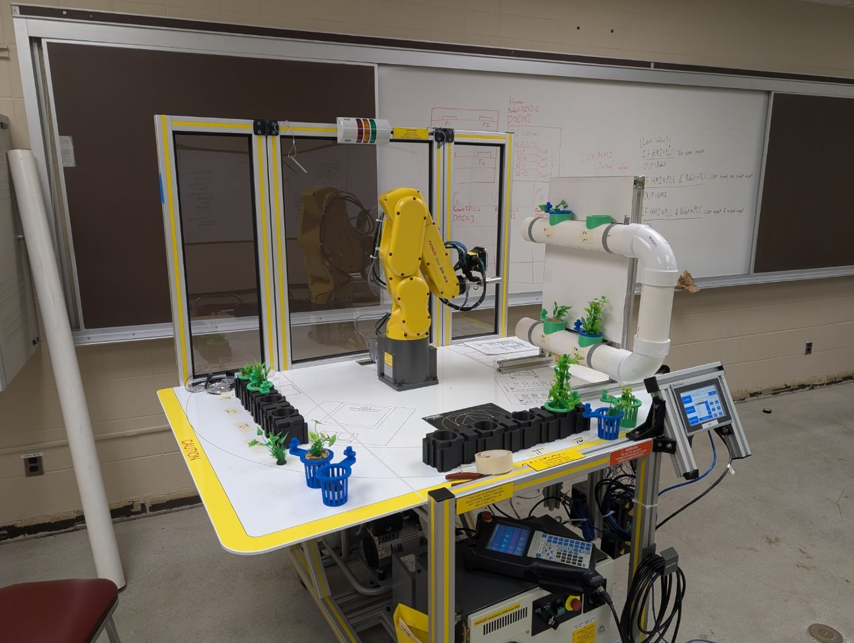
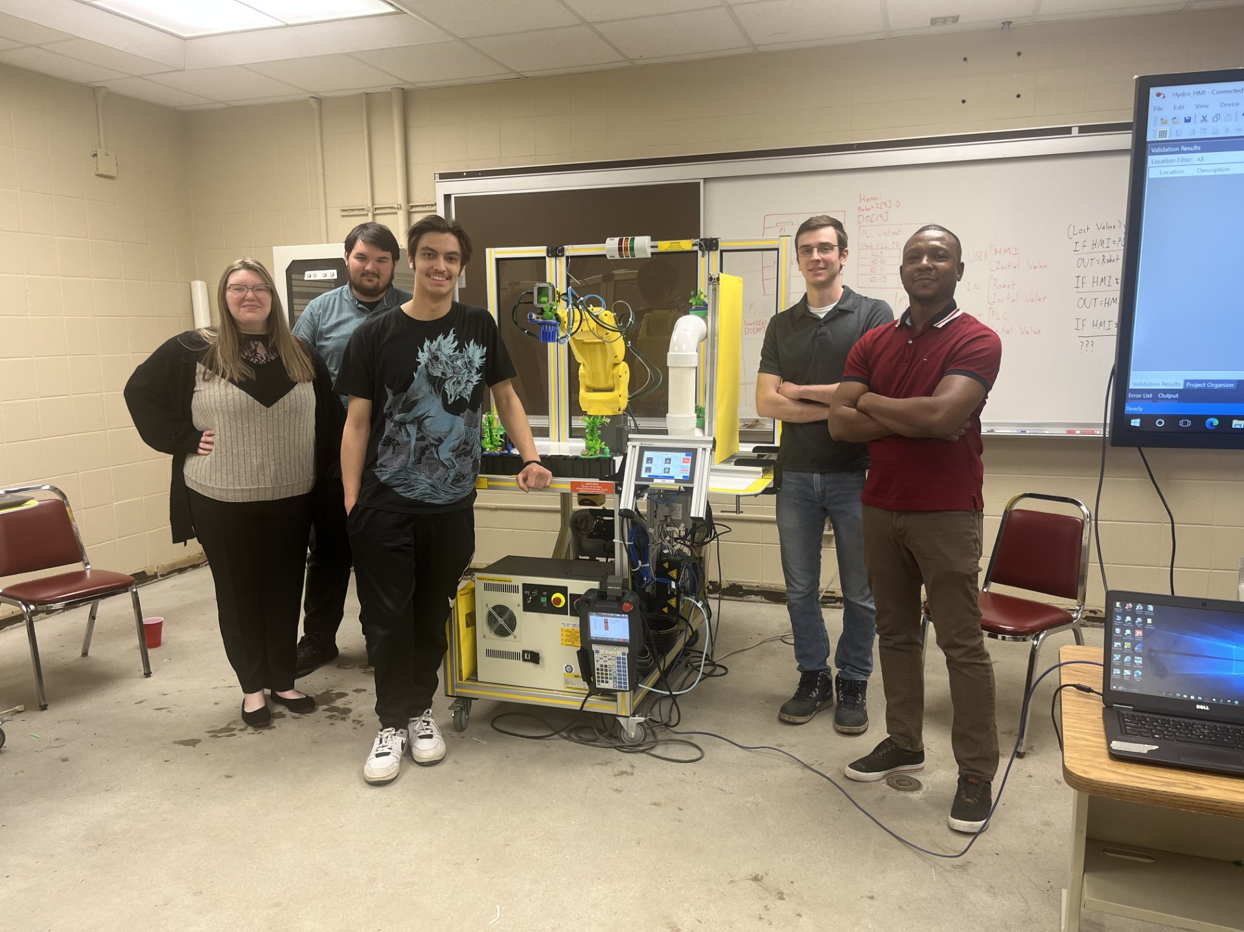
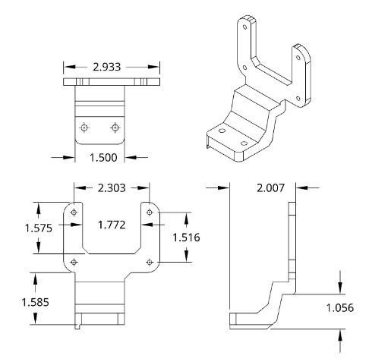
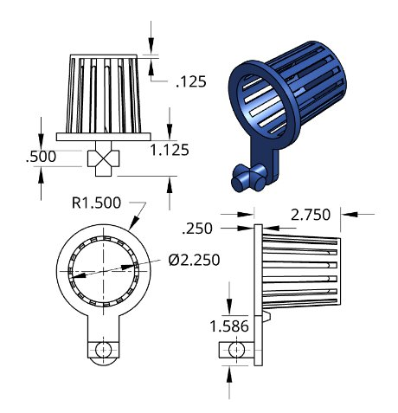
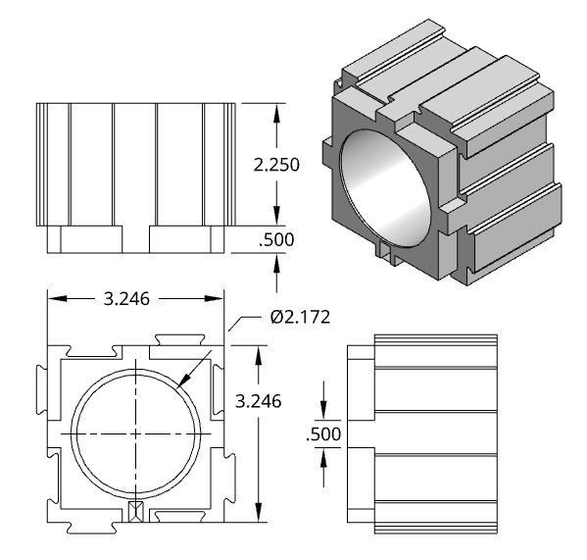
Self-Sustaining Hydroponic System Cathern (Katie) Barty, Kevin Jacobs, Adam Siegfried,
Devin Spiegelberg, Brandon Strait
Abstract
Methodology and Implementation
Results and Discussion
Conclusion
This project aims to create a self-sustaining hydroponic system utilizing a Fanuc robot and a PLC (Programmable Logic Controller) to grow crops with minimal intervention. The hydroponic system was developed with a primary focus on the robotic system's operation to monitor the plant growth process.
The underlying tools to achieve the desired outcome are a Fanuc Robot (ER-4iA) and its teach pendant, a Cognex camera (Insight 7802C) with the insight explorer software, and a Rockwell automation PLC (Model) and MHI (Human Machine Interface) running on the Studio 5000 software and factory talk, respectively.
Various challenges were overcome, such as establishing communication between the robot and the PLC and aligning the robot's outputs with the PLC's input to synchronize plant counts and send commands to the robot via the HMI screen.
Ultimately, this project successfully achieved its goals, and the system operates effectively.
The HMI element of the robot features several screens that offer a variety of options to the end user.
The main menu has basic plant
and system information, as
well as links to in-depth
screens
Individual plant screens have
settings for each plant and
specific growth data
The PLC Program acts as the main processor for the Self-Sustaining System, relaying information between the Robot, Camera, and HMI while keeping track of the robot’s status and plant values.
The plants are analyzed using a Cognex Insight 7802C camera in conjunction with Insight Explorer software. When the robot analyzes a plant, it takes a picture that is sent to Insight Explorer. The software counts the black pixels, which represent the plant, and sends this value to the PLC. This information is then used to determine the growth stage based on our predefined parameters.
The robot analyzes the plants and available slots at the growing station. If a plant is not fully mature, it is left alone while the next slot is examined. Once a plant reaches maturity, it is taken to the "done" station. If a slot is open, a plant is selected from the seedling station and brought to the growing station.
The project aimed to create a self-sustaining hydroponic system utilizing a Fanuc robot, a PLC (Programmable Logic Controller)to grow crops with minimal intervention. Through numerous trials and errors, we overcame challenges such as establishing communication between the robot, PLC, determining the correct outputs of the robot to align them with the PLC’s inputs, and synchronizing the plant count between the PLC and the robot. Ultimately, this project successfully met its original goals, and the system's function performs admirably.
HMI Interface
PLC Programming
References
Main Program
Growth Subroutine
Ethernet Connections
[1] D. Rodríguez-Nieto, E. Navas, and R. Fernández, “Automated seeding in hydroponic greenhouse with a dual-arm robotic system | IEEE Journals & Magazine | IEEE Xplore,” Automated Seeding in Hydroponic Greenhouse With a Dual-Arm Robotic System, https://ieeexplore.ieee.org/abstract/document/10884759 (accessed Apr. 28, 2025).
[2] Anurag Shrivastava a et al., “Automatic robotic system design and development for vertical hydroponic farming using IOT and Big Data Analysis,” Materials Today: Proceedings, https://www.sciencedirect.com/science/article/abs/pii/S2214785321051531 (accessed Apr. 27, 2025).
[3] Haider Ali Khan a 1 et al., “Design and development of machine vision robotic arm for vegetable crops in hydroponics,” Smart Agricultural Technology, https://www.sciencedirect.com/science/article/pii/S2772375524002338 (accessed Apr. 27, 2025).
[4] Jung Eek Son 1, 1, 2, and A. systems, “Hydroponic Systems,” Plant Factory (Second Edition), https://www.sciencedirect.com/science/article/abs/pii/B9780128166918000200 (accessed Apr.27, 2025).
Syncing Subroutine
Introduction
Camera View
Project/Prototype Images
Project Team
Food scarcity remains a significant issue in the world and particularly the United States. A major contributor to this issue are food deserts: Food deserts are areas where access to nutritious and affordable food is severely limited. Surprisingly, food deserts are most common in urban areas. This development is due to limited space forcing urban areas to import produce which is also insufficiently transported.
This project aims to combat food scarcity by using robotics in hydroponic farming. By automating the planting and harvesting process, it creates a self-sustaining farming method, ensuring a more reliable and local source of healthy fruits and vegetables in urban areas.
Custom 3D Printed Parts
Camera mount
Plant Cup
Plant Cup Base
Acknowledgements
Funding Source: Center for Undergraduate
Research and Scholarship (CURS)
Dr. Muteb Aljasem
Dr. Sonia Chacko

